Slide 1
Towards a Command-Line Autocorrect Tool
Grady McPeak
CSCI 6907 Final Project

Slide 2
Why Aren’t CLIs Fancier?
Accessibility in CLIs
Lowering the barrier to becoming a “power user”
Increasing computer literacy of average users
GUIs are slow and heavy!
If this is going into a CLI, it needs to be as light as possible

Slide 3
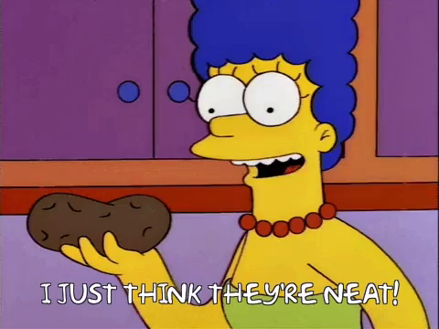
Why Aren’t CLIs Fancier?

Slide 4
Can We Generate Typos?
Command dataset from Ubuntu man pages
command names and associated flags

Slide 5
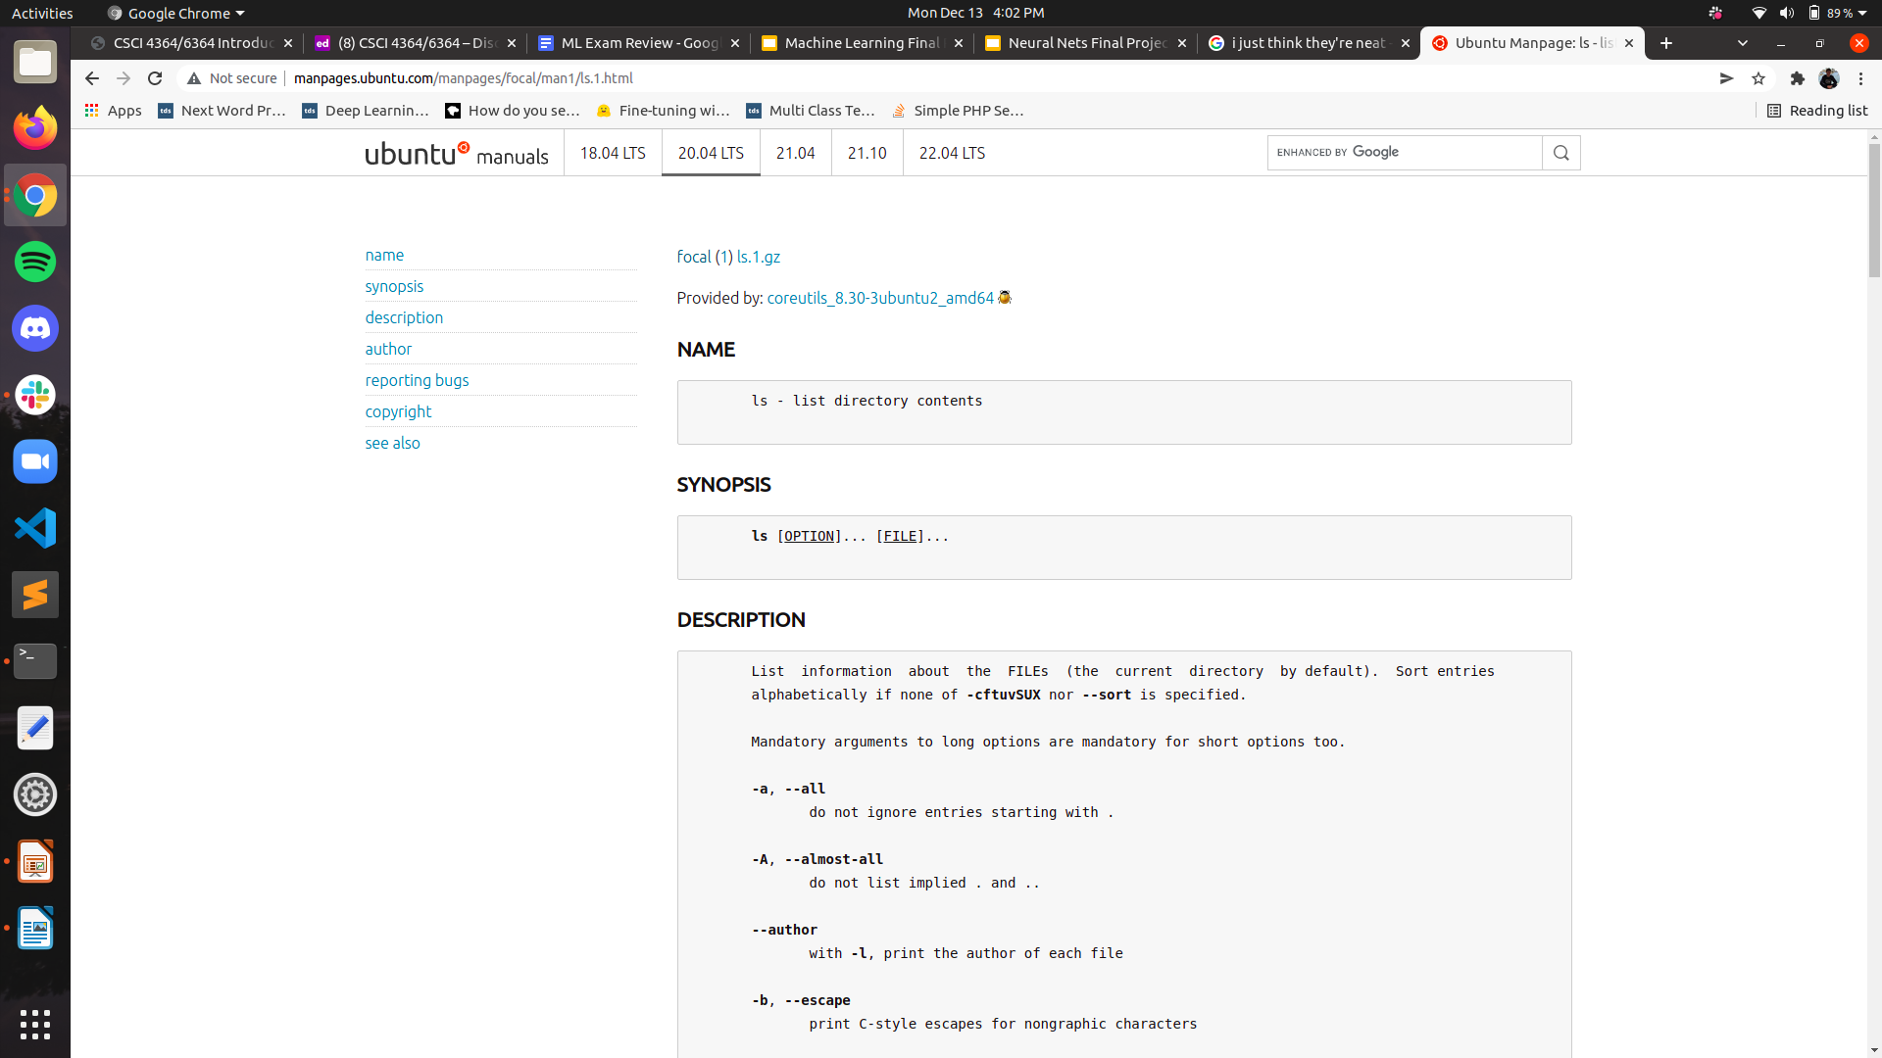
Can We Recognize Typos?
Dataset of Ubuntu man pages
command names and associated flags

Slide 6
Can We Generate Typos?
Synthetic dataset of typos with associated flags
1 or two incorrect keystrokes
One flag
Flag is not able to be a typo, since it is usually only one letter

Slide 7
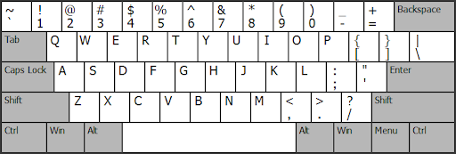
Can We Generate Typos?
Synthetic dataset of typos with associated flags
1 or two incorrect keystrokes
One flag
Flag is not able to be a typo, since it is usually only one letter

Slide 8
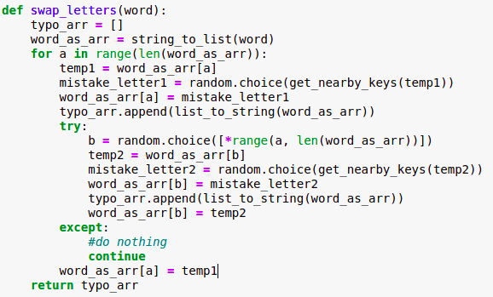

Slide 9
Can We Generate Typos?
input: ‘command’
['fommand', 'tommand', 'cpmmand', 'cpmmajd', 'cokmand', 'cokkand', 'comnand', 'comnahd', 'commwnd', 'commwne', 'commabd', 'commabe', 'commanr', 'commanf']

Slide 10
Can We Encode Typos?

Slide 11
Can We Encode Typos?
input: ‘cpmmajd’
[c, p, m, m, a, j, d]

Slide 12
Can We Encode Typos?
input: ‘cpmmajd’
[c, p, m, m, a, j, d]
[3, 16, 13, 13, 1, 10, 4]

Slide 13
Can We Encode Typos?
[3, 16, 13, 13, 1, 10, 4]
[3, 16, 13, 13, 1, 10, 4, …, X]

Slide 14
Can We Recognize Typos?
Model structure: input size ➝ larger hidden layer ➝ less large hidden layer ➝ output layer
Hidden layers ALWAYS larger than output layer
For my testing, I took a subset of 74 commands to classify

Slide 15
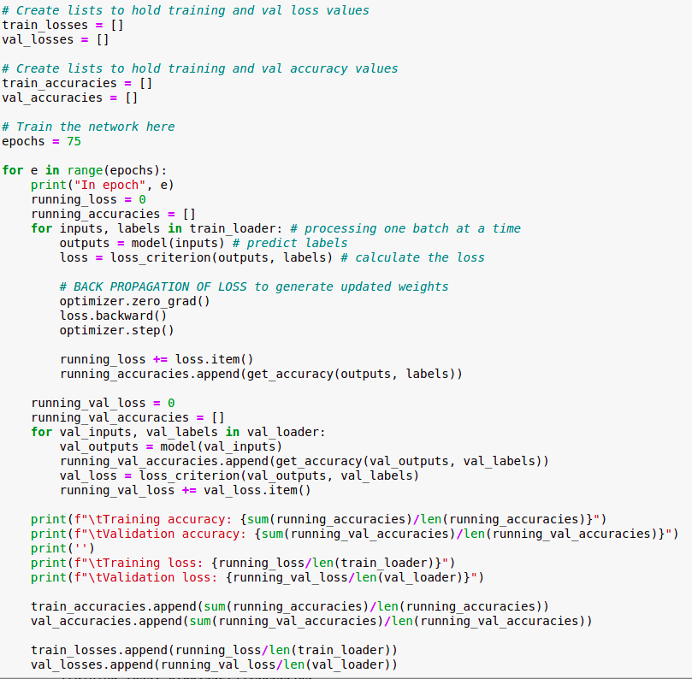

Slide 16
Can We Recognize Typos?
Validation Loss: 0.008 ➝ 0.002
Validation Accuracy: 51.6% ➝ 89.4%

Slide 17
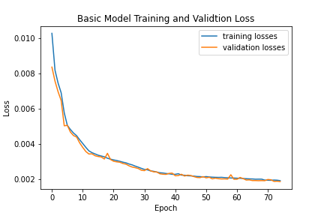
Can We Recognize Typos?

Slide 18
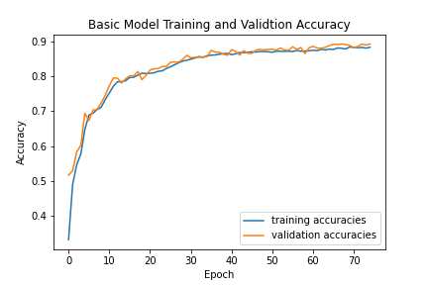
Can We Recognize Typos?

